Slide 1
Digital Portfolio
STUDENT NAME:BHARATH.S
REGISTER NO AND NMID: 222407608
DEPARTMENT: BSC
COLLEGE: VEL TECH RANGA SANKU ARTS COLLEGE/ UNIVERSITY OF MADRAS

Slide 2
PROJECT TITLE
DIGITAL PORTFOLIO

Slide 3

AGENDA
Problem statement
Project overview
End user
Tools and technology
Portfolio design and layout
Features and functionality
Results and screenshots
Conclusion
Github link

Slide 4

PROBLEM STATEMENT
★Lack of a professional online identity for students. ★Traditional resumes are static and less engaging. ★Need for a digital portfolio that highlights projects, skills, and achievements effectively.

Slide 5
PROJECT OVERVIEW
★A Personal Portfolio Website built using HTML, CSS, and JavaScript.
★Provides structured sections: About, Skills, Certificates, Projects, and Contact.
★Designed to be responsive, interactive, and user-friendly.

Slide 6

WHO ARE THE END USERS?
★Students who want to showcase their academic and project work.
★Recruiters/HR professionals searching for talent.
★Teachers and mentors evaluating project submissions.
★General qudience interested in portfolioreference designs

Slide 7
POTFOLIO DESIGN AND LAYOUT
★Header & Navbar → Quick navigation
★Hero Section → Introduction + Tagline
★About Section → Bio + Image
★Skills Section → Progress bars
★Certificates Section → Achievements list
★Projects Section → Showcase with cards
★Contact Section → Form + Social links
★Footer → GitHub & LinkedIn
7

Slide 8
TOOLS AND TECHNIQUES
HTML – Structure
CSS – Styling & layout
JavaScript – Functionality
VS code – IDE
Github – Version control& hosting

Slide 9
FEATURES AND FUNCTIONALITY
Responsive navigation bar mobile and desktop view.
Dark mode toggle interactive skill progress bars.
Contact from with validation & success message project showcase
using cards with overaffects.
Social links for networking (Github & Linkedin).

Slide 10
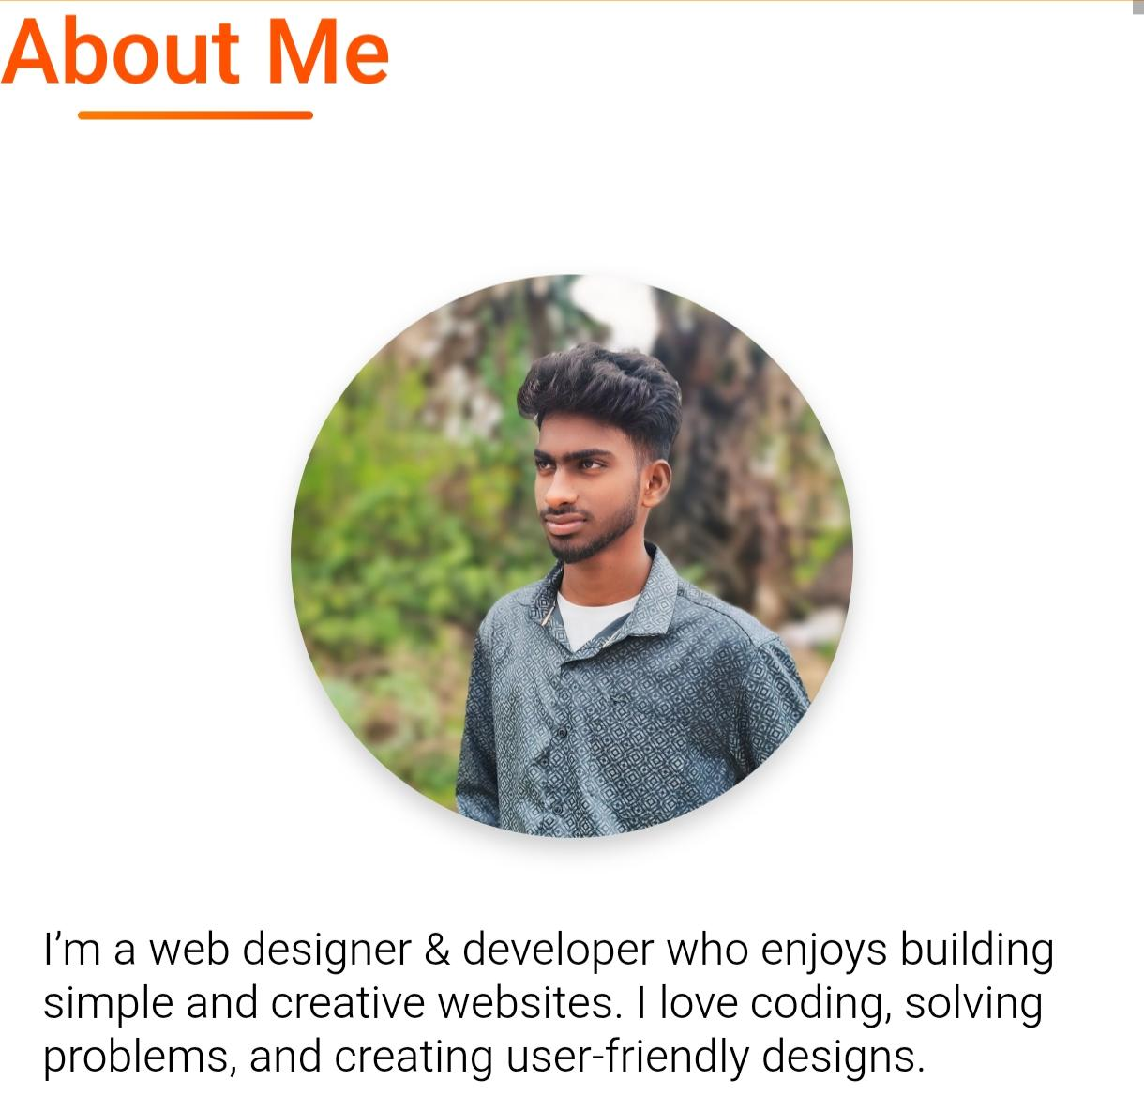
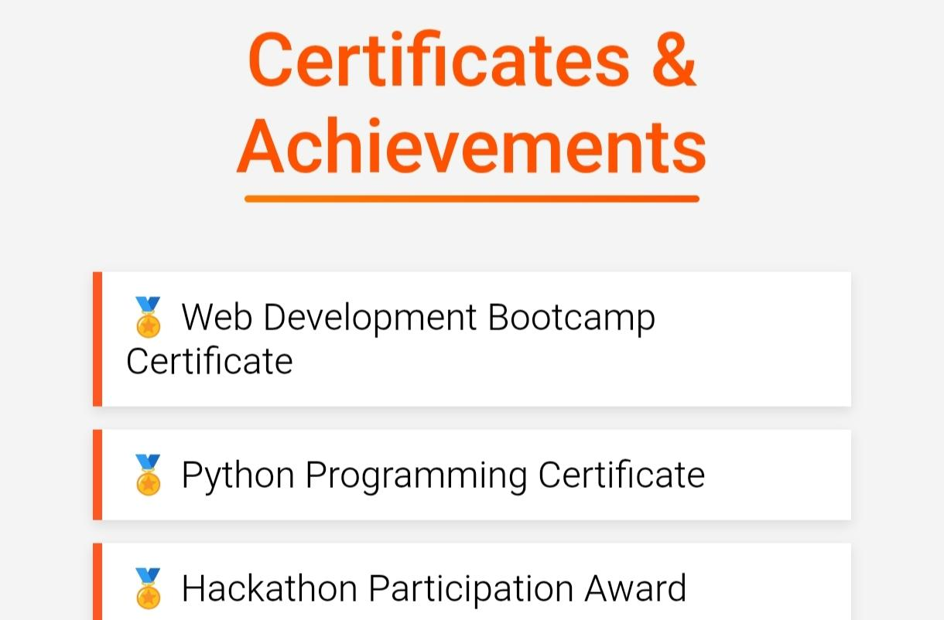
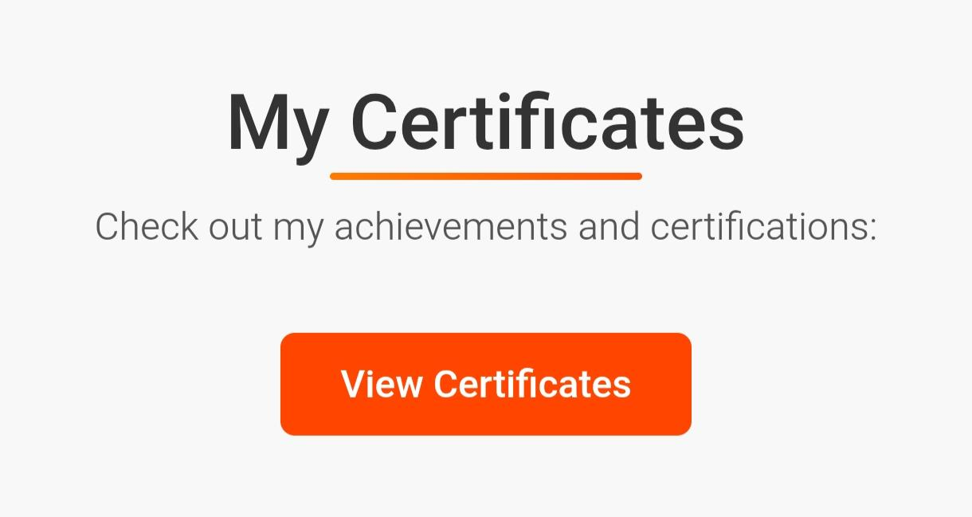
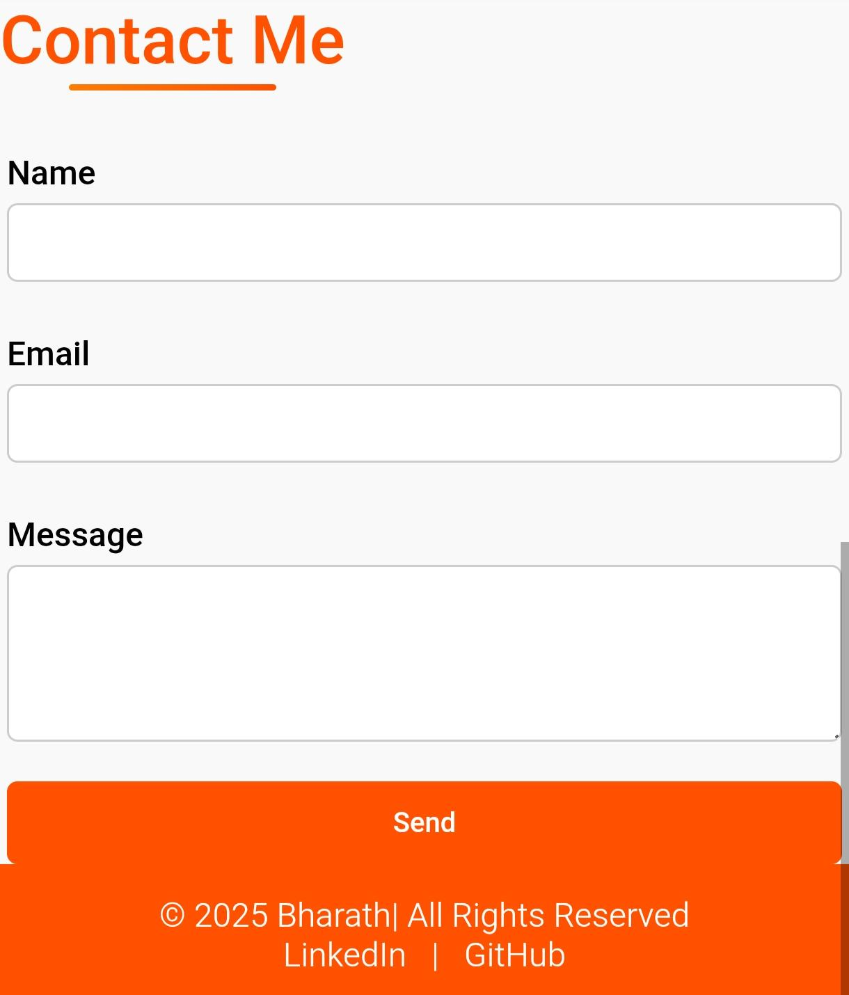
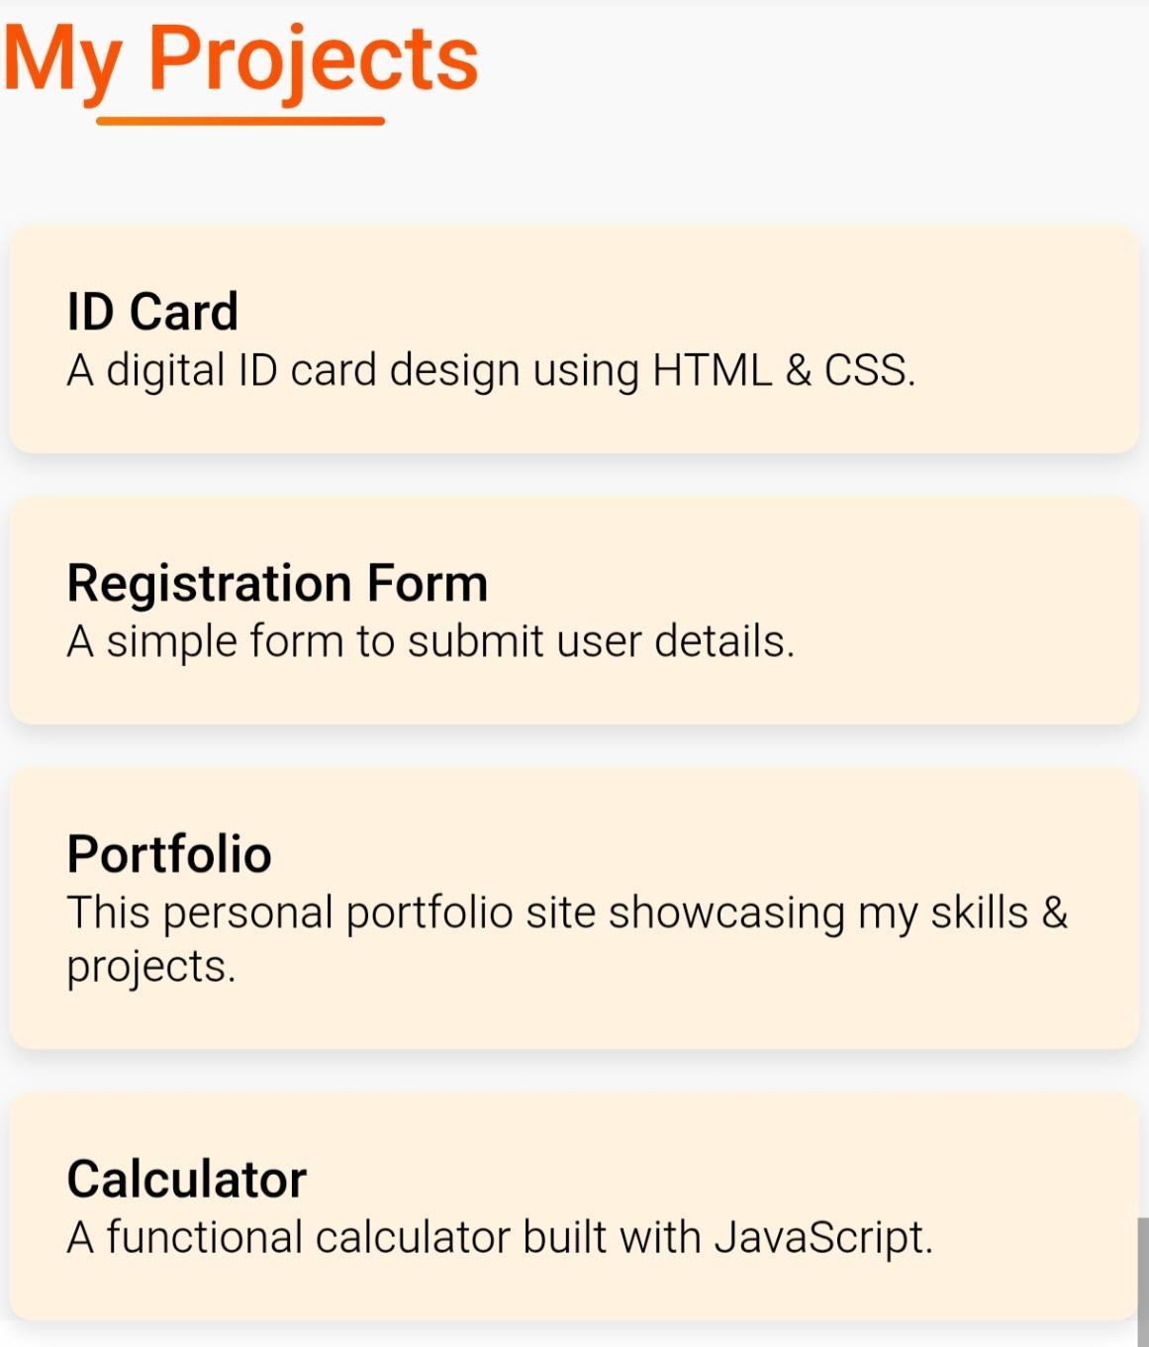
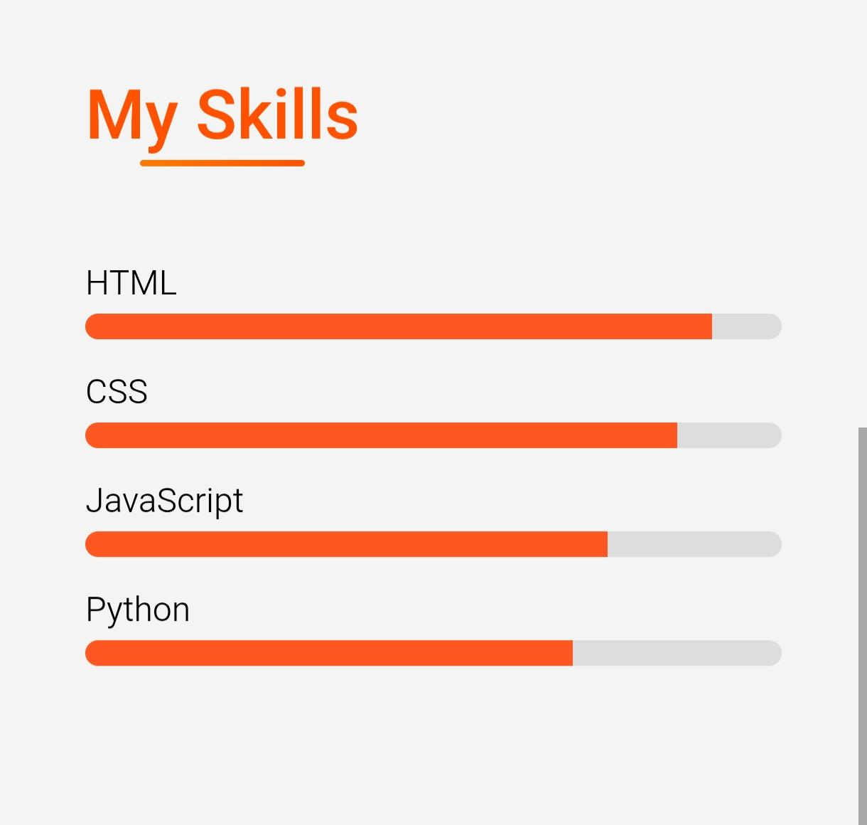
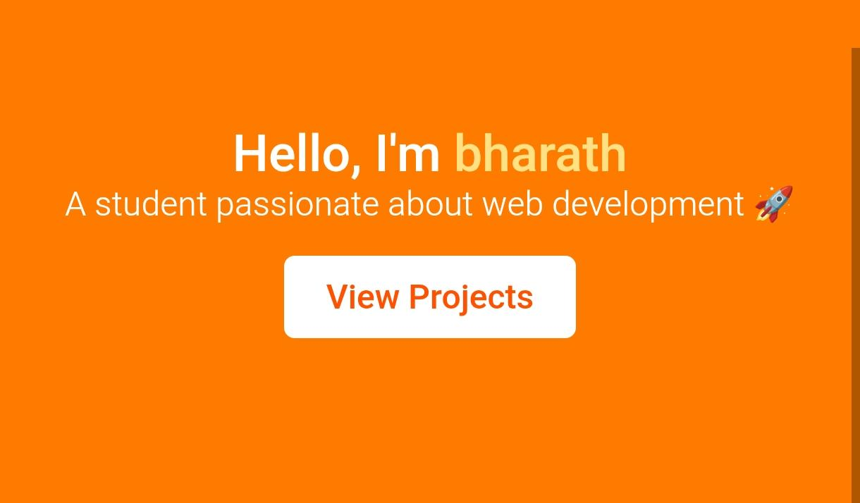
RESULTS AND SCREENSHOTS
★Completed a working digital portfolio website ★Successfully integrated skills, projects, and certificates ★Screenshots of key sections: Home Page ★Skills Page ★Project Showcase Contact Page
3/21/2024 Annual Review
10

Slide 11
CONCLUSION
The project demonstrates web development skills .
Provides a digital resume for better professional visibility.
Increases chances of internships and job opportunities.
11

